Slide 1
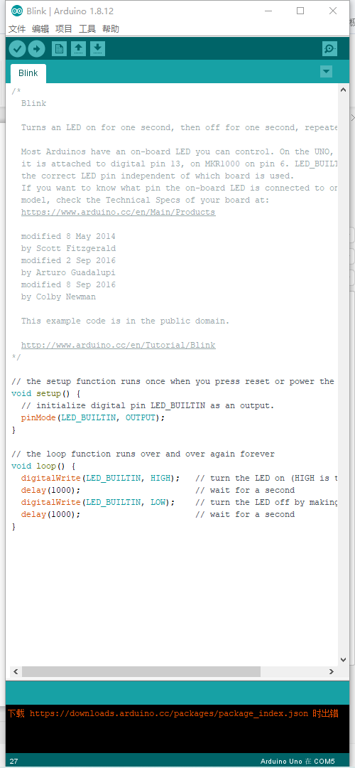
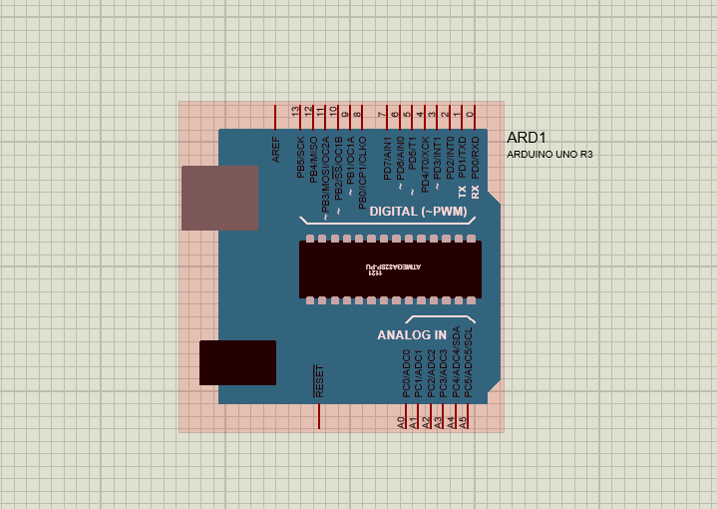
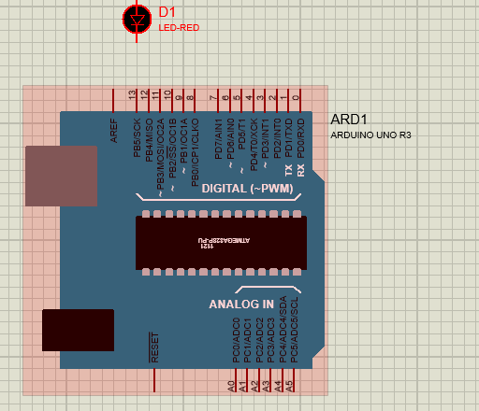
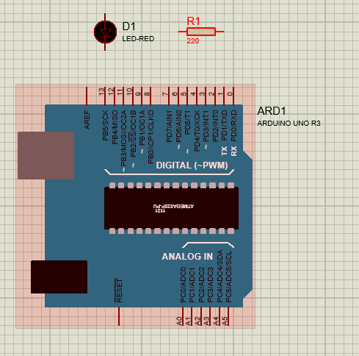
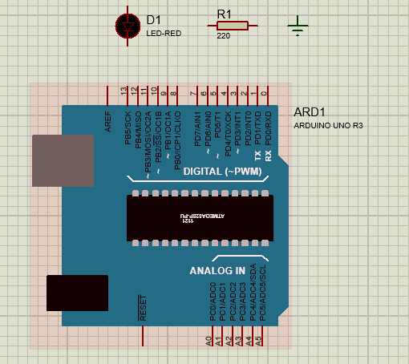
Steps | Task
ADD ARDUINO UNO R3 DEVIDE
USB A-to-B Cable
Breadboard
ADD LED 5mm
ADD 220Ω Resister
ADD Jumper Wires

Slide 2
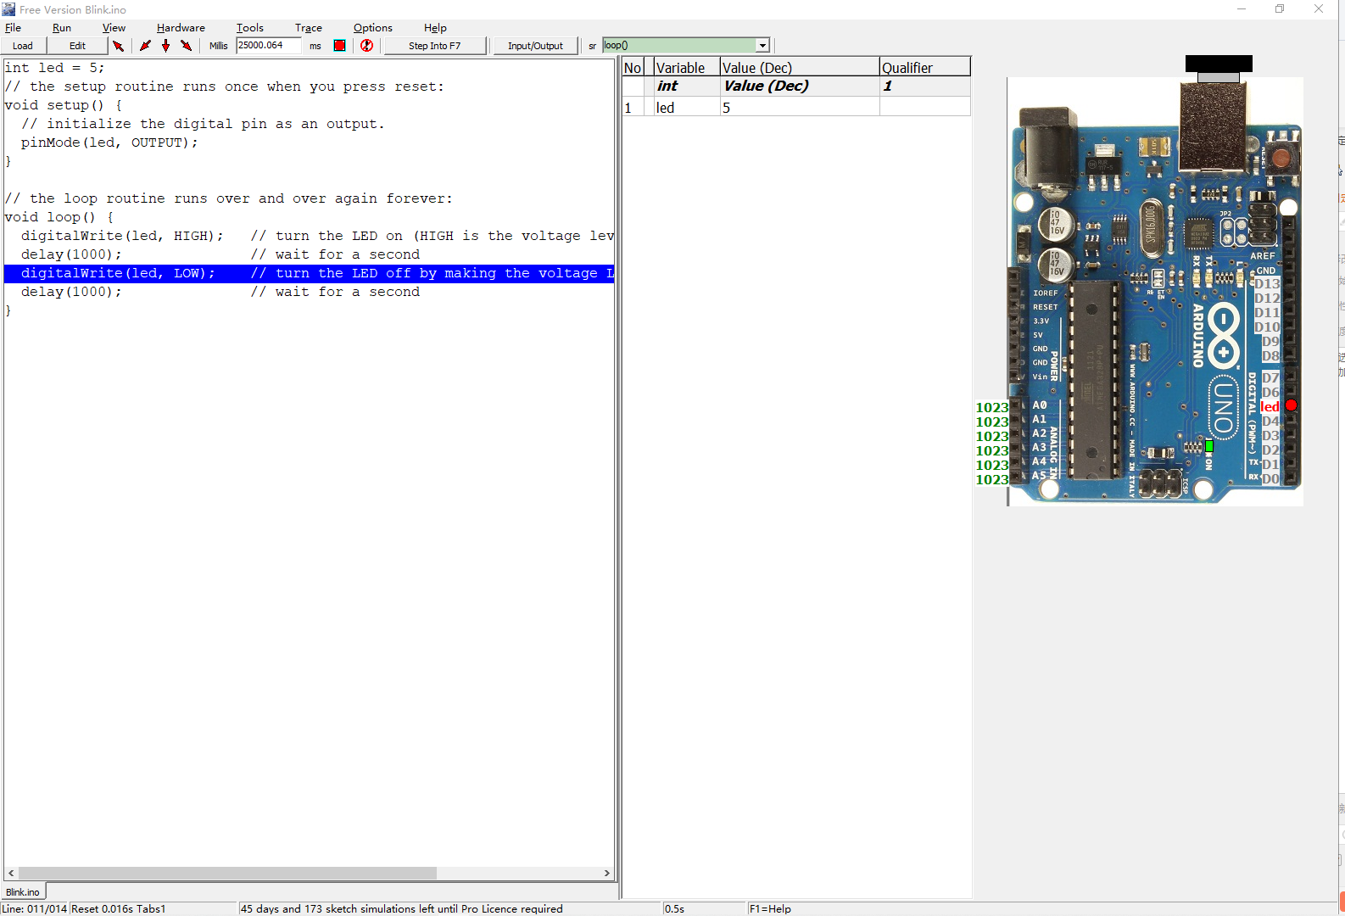
blink：the red led is flashing

